Slide 1
The Model-Driven Test Design Process
Farn Wang
Dept. of Electrica Engineering
National Taiwan University
Thanks to Prof. Ammann & Offutt for the original slides.

Slide 2
Testing in the 21st Century
Software defines behavior
  network routers, finance, switching networks, other infrastructure
Today’s software market :
  is much bigger
  is more competitive
  has more users
Embedded Control Applications
  airplanes, air traffic control
  spaceships
  watches
  ovens
  remote controllers
Agile processes put increased pressure on testers
  Programmers must unit test – with no training, education or tools !
  Tests are key to functional requirements – but who builds those tests ?
Industry is going through a revolution in what testing means to the success of software products
  PDAs
  memory seats
  DVD players
  garage door openers
  cell phones
ITRI 2013

Slide 3
OUTLINE
Spectacular Software Failures
Why Test?
What Do We Do When We Test ?
  Test Activities and Model-Driven Testing
Software Testing Terminology
Changing Notions of Testing
Test Maturity Levels
Summary
ITRI 2013

Slide 4

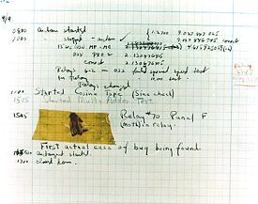
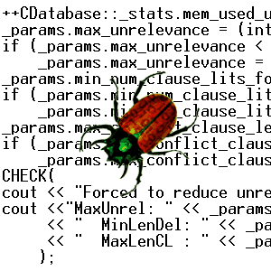

The First Bugs
Hopper’s
“bug” (moth
stuck in a
relay on an
early machine)
“an analyzing process must equally have been performed in order to furnish the Analytical Engine with the necessary operative data; and that herein may also lie a possible source of error. Granted that the actual mechanism is unerring in its processes, the cards may give it wrong orders. ” – Ada, Countess Lovelace (notes on Babbage’s Analytical Engine)
“It has been just so in all of my inventions. The first step is an intuition, and comes with a burst, then difficulties arise—this thing gives out and [it is] then that 'Bugs'—as such little faults and difficulties are called—show themselves and months of intense watching, study and labor are requisite. . .” – Thomas Edison
ITRI 2013

Slide 5
Costly Software Failures
CoPQ
NIST report, “The Economic Impacts of Inadequate Infrastructure for Software Testing” (2002)
  Inadequate software testing costs the US alone between $22 and $59 billion annually
  Better approaches could cut this amount in half
Huge losses due to web application failures
  Financial services : $6.5 million per hour (just in USA!)
  Credit card sales applications : $2.4 million per hour (in USA)
In Dec 2006, amazon.com’s BOGO offer turned into a double discount
2007 : Symantec says that most security vulnerabilities are due to faulty software
World-wide monetary loss due to poor software is staggering
ITRI 2013

Slide 6


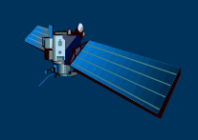
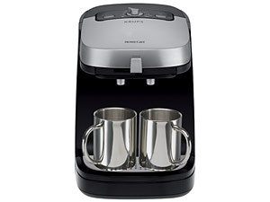




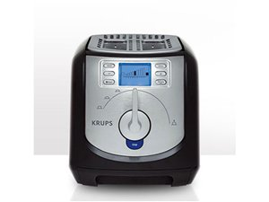
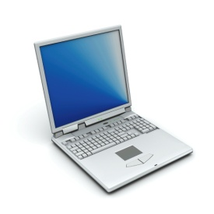




Software is a Skin that Surrounds Our Civilization
Quote due to Dr. Mark Harman
ITRI 2013

Slide 7

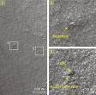
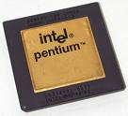
Spectacular Software Failures
NASA’s Mars lander: September 1999, crashed due to a units integration fault
Ariane 5:
exception-handling
bug : forced self
destruct on maiden
flight (64-bit to 16-bit
conversion: about
370 million $ lost)
Mars Polar
Lander crash
site?
Toyota brakes : Dozens dead, thousands of crashes
Major failures: Ariane 5 explosion, Mars Polar Lander, Intel’s Pentium FDIV bug
We need our software to be dependable
Testing is one way to assess dependability
ITRI 2013

Slide 8

Airbus 319 Safety Critical Software Control
Loss of autopilot
Loss of most flight deck lighting and intercom
Loss of both the commander’s and the co‑pilot’s primary flight and navigation displays !
ITRI 2013

Slide 9

Northeast Blackout of 2003
508 generating units and 256 power plants shut down
Affected 10 million people in Ontario, Canada
Affected 40 million people in 8 US states
Financial losses of
$6 Billion USD
The alarm system in the energy management system failed due to a software error and operators were not informed of the power overload in the system
ITRI 2013

Slide 10
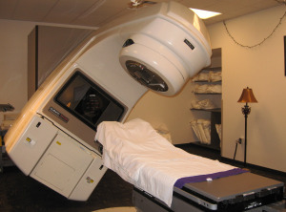
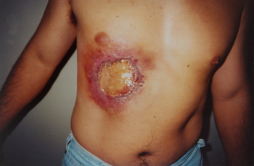
Poor testing of safety-critical software
Therac-25: medical linear accelerator by AECL
6 accidents with 3 death and serious injuries from 6/1985 to 1/1987
ITRI 2013

Slide 11
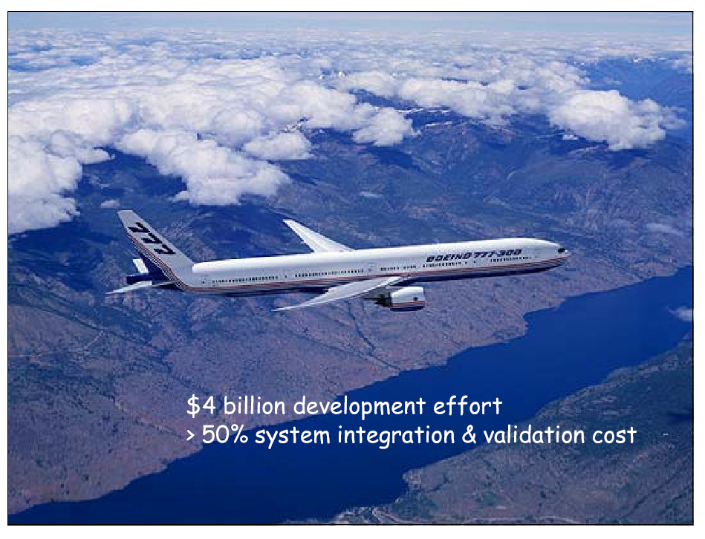
Embedded and real-time systems
- the modern ones
2,500,000+1,500,000 lines of codes (most in Ada)
ITRI 2013

Slide 12
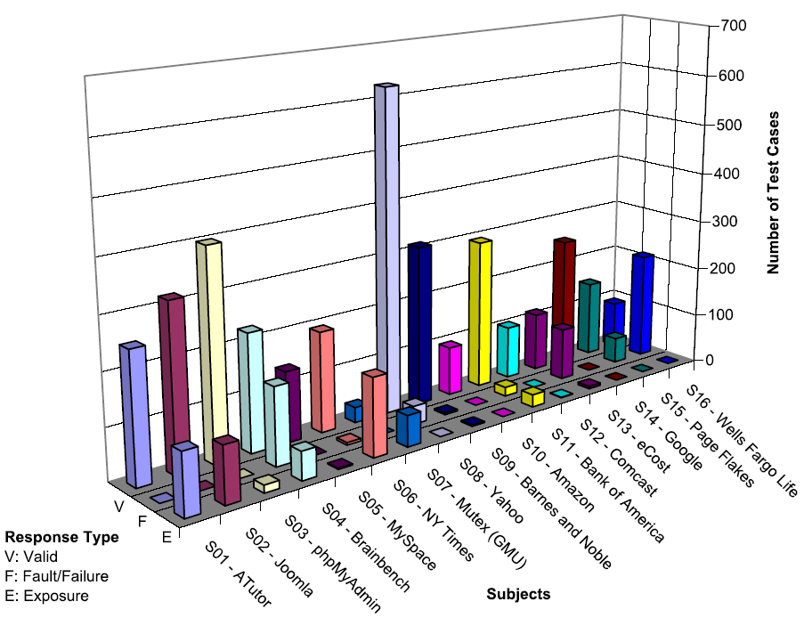
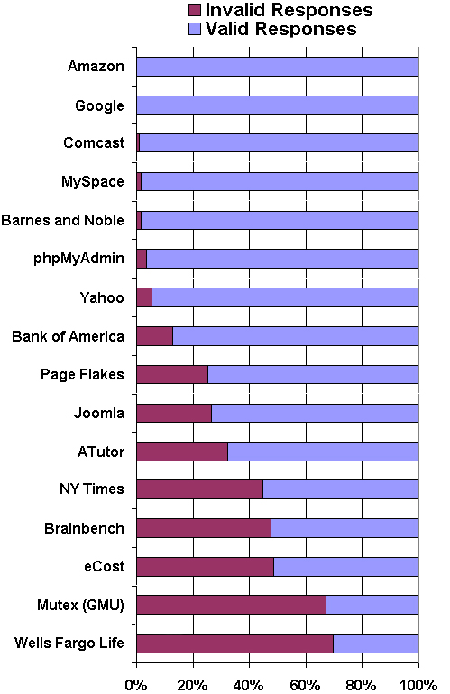
Bypass Testing Results for web input validations
v
— Vasileios Papadimitriou. Masters thesis, Automating Bypass Testing for Web Applications, GMU 2006
ITRI 2013

Slide 13

What Does This Mean?
Software testing is getting more important
ITRI 2013

Slide 14
Testing in the 21st Century
More safety critical, real-time software
Embedded software is ubiquitous … check your pockets
Enterprise applications means bigger programs, more users
Paradoxically, free software increases our expectations !
Security is now all about software faults
  Secure software is reliable software
The web offers a new deployment platform
  Very competitive and very available to more users
  Web apps are distributed
  Web apps must be highly reliable
Industry desperately needs our inventions !
ITRI 2013

Slide 15
OUTLINE
Spectacular Software Failures
Why Test?
What Do We Do When We Test ?
  Test Activities and Model-Driven Testing
Software Testing Terminology
Changing Notions of Testing
Test Maturity Levels
Summary
ITRI 2013

Slide 16

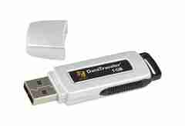
Here! Test This!
My first “professional” job
Big software program
MicroSteff – big
software system
for the mac
V.1.5.1 Jan/2007
Jan/2007
Verdatim
DataLife
MF2-HD
1.44 MB
A stack of computer printouts—and no documentation
ITRI 2013

Slide 17
Cost of Testing
You’re going to spend at least half of your development budget on testing, whether you want to or not
In the real-world, testing is the principle post-design activity
Restricting early testing usually increases cost
Extensive hardware-software integration requires more testing
ITRI 2013

Slide 18
Why Test?
If you don’t know why you’re conducting each test, it won’t be very helpful
Written test objectives and requirements must be documented
What are your planned coverage levels?
How much testing is enough?
Common objective – spend the budget … test until the ship-date …
  Sometimes called the “date criterion”
ITRI 2013

Slide 19
Why Test?
If you don’t start planning for each test when the functional requirements are formed, you’ll never know why you’re conducting the test
1980: “The software shall be easily maintainable”
Threshold reliability requirements?
What fact is each test trying to verify?
Requirements definition teams need testers!
ITRI 2013

Slide 20
Cost of Not Testing
Program Managers often say: “Testing is too expensive.”
Not testing is even more expensive
Planning for testing after development is prohibitively expensive
A test station for circuit boards costs half a million dollars …
Software test tools cost less than $10,000 !!!
ITRI 2013

Slide 21
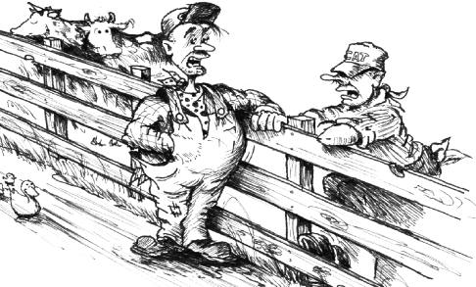
1990s Thinking
They’re teaching a new way
of plowing over at the Grange
tonight - you going?
Naw - I already don’t plow as good as I know how...
Fail !!!
“Knowing is not enough, we must apply. Willing is not enough, we must do.” Goethe
ITRI 2013

Slide 22
OUTLINE
Spectacular Software Failures
Why Test?
What Do We Do When We Test ?
  Test Activities and Model-Driven Testing
Software Testing Terminology
Changing Notions of Testing
Test Maturity Levels
Summary
ITRI 2013

Slide 23
Test Design in Context
Test Design is the process of designing input values that will effectively test software
Test design is one of several activities for testing software
  Most mathematical
  Most technically challenging
ITRI 2013

Slide 24
Types of Test Activities
Testing can be broken up into four general types of activities
  Test Design
  Test Automation
  Test Execution
  Test Evaluation
Each type of activity requires different skills, background knowledge, education and training
No reasonable software development organization uses the same people for requirements, design, implementation, integration and configuration control
    1.a) Criteria-based
    1.b) Human-based
Why do test organizations still use the same people for all four test activities??
This is clearly a waste of resources
ITRI 2013

Slide 25
1. Test Design – (a) Criteria-Based
Design test values to satisfy coverage criteria or other engineering goal
This is the most technical job in software testing
Requires knowledge of :
  Discrete math
  Programming
  Testing
Requires much of a traditional CS degree
This is intellectually stimulating, rewarding, and challenging
Test design is analogous to software architecture on the development side
Using people who are not qualified to design tests is a sure way to get ineffective tests
ITRI 2013

Slide 26
1. Test Design – (b) Human-Based
Design test values based on domain knowledge of the program and human knowledge of testing
This is much harder than it may seem to developers
Criteria-based approaches can be blind to special situations
Requires knowledge of :
  Domain, testing, and user interfaces
Requires almost no traditional CS
  A background in the domain of the software is essential
  An empirical background is very helpful (biology, psychology, …)
  A logic background is very helpful (law, philosophy, math, …)
This is intellectually stimulating, rewarding, and challenging
  But not to typical CS majors – they want to solve problems and build things
ITRI 2013

Slide 27
2. Test Automation
Embed test values into executable scripts
This is slightly less technical
Requires knowledge of programming
  Fairly straightforward programming – small pieces and simple algorithms
Requires very little theory
Very boring for test designers
Programming is out of reach for many domain experts
Who is responsible for determining and embedding the expected outputs ?
  Test designers may not always know the expected outputs
  Test evaluators need to get involved early to help with this
ITRI 2013

Slide 28
3. Test Execution
Run tests on the software and record the results
This is easy – and trivial if the tests are well automated
Requires basic computer skills
  Interns
  Employees with no technical background
Asking qualified test designers to execute tests is a sure way to convince them to look for a development job
If, for example, GUI tests are not well automated, this requires a lot of manual labor
Test executors have to be very careful and meticulous with bookkeeping
ITRI 2013

Slide 29
4. Test Evaluation
Evaluate results of testing, report to developers
This is much harder than it may seem
Requires knowledge of :
  Domain
  Testing
  User interfaces and psychology
Usually requires almost no traditional CS
  A background in the domain of the software is essential
  An empirical background is very helpful (biology, psychology, …)
  A logic background is very helpful (law, philosophy, math, …)
This is intellectually stimulating, rewarding, and challenging
  But not to typical CS majors – they want to solve problems and build things
ITRI 2013

Slide 30
Other Activities
Test management : Sets policy, organizes team, interfaces with development, chooses criteria, decides how much automation is needed, …
Test maintenance : Save tests for reuse as software evolves
  Requires cooperation of test designers and automators
  Deciding when to trim the test suite is partly policy and partly technical – and in general, very hard !
  Tests should be put in configuration control
Test documentation : All parties participate
  Each test must document “why” – criterion and test requirement satisfied or a rationale for human-designed tests
  Ensure traceability throughout the process
  Keep documentation in the automated tests
ITRI 2013

Slide 31
Types of Test Activities – Summary
1a. | Design | Design test values to satisfy engineering goals
 | Criteria | Requires knowledge of discrete math, programming and testing
1b. | Design | Design test values from domain knowledge and intuition
 | Human | Requires knowledge of domain, UI, testing
2. | Automation | Embed test values into executable scripts
 |  | Requires knowledge of scripting
3. | Execution | Run tests on the software and record the results
 |  | Requires very little knowledge
4. | Evaluation | Evaluate results of testing, report to developers
 |  | Requires domain knowledge
These four general test activities are quite different
It is a poor use of resources to use people inappropriately
ITRI 2013

Slide 32
Organizing the Team
A mature test organization needs only one test designer to work with several test automators, executors and evaluators
Improved automation will reduce the number of test executors
  Theoretically to zero … but not in practice
Putting the wrong people on the wrong tasks leads to inefficiency, low job satisfaction and low job performance
  A qualified test designer will be bored with other tasks and look for a job in development
  A qualified test evaluator will not understand the benefits of test criteria
Test evaluators have the domain knowledge, so they must be free to add tests that “blind” engineering processes will not think of
The four test activities are quite different
Many test teams use the same people for ALL FOUR activities !!
ITRI 2013

Slide 33
Applying Test Activities
To use our people effectively
and to test efficiently
we need a process that
lets test designers
raise their level of abstraction
ITRI 2013

Slide 34
Using MDTD in Practice
This approach lets one test designer do the math
Then traditional testers and programmers can do their parts
  Find values
  Automate the tests
  Run the tests
  Evaluate the tests
  Just like in traditional engineering … an engineer constructs models with calculus, then gives direction to carpenters, electricians, technicians, …
Testers ain’t mathematicians !
ITRI 2013

Slide 35
Model-Driven Test Design
refined requirements / test specs
model / structure
test requirements
test requirements
DESIGN
ABSTRACTION
LEVEL
IMPLEMENTATION
ABSTRACTION
LEVEL
software artifact
input values
pass / fail
test results
test scripts
test cases
ITRI 2013

Slide 36
Model-Driven Test Design – Steps
criterion
refine
refined requirements / test specs
model / structure
test requirements
generate
analysis
test requirements
domain analysis
DESIGN
ABSTRACTION
LEVEL
IMPLEMENTATION
ABSTRACTION
LEVEL
software artifact
input values
feedback
evaluate
execute
automate
prefix
postfix
expected
pass / fail
test results
test scripts
test cases
ITRI 2013

Slide 37

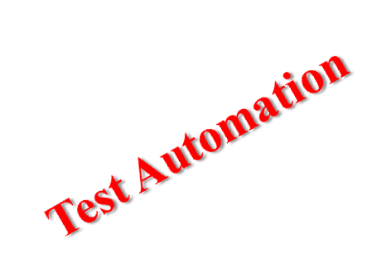
Model-Driven Test Design – Activities
refined requirements / test specs
model / structure
test requirements
Test Design
DESIGN
ABSTRACTION
LEVEL
Raising our abstraction level makes
test design MUCH easier
IMPLEMENTATION
ABSTRACTION
LEVEL
software artifact
input values
pass / fail
test results
test scripts
test cases
Test Evaluation
Test Execution
ITRI 2013

Slide 38
Small Illustrative Example
Software Artifact : Java Method
/**
* Return index of node n at the
* first position it appears,
* -1 if it is not present
*/
public int indexOf (Node n)
{
for (int i=0; i < path.size(); i++)
if (path.get(i).equals(n))
return i;
return -1;
}
Control Flow Graph
1
i = 0
2
i < path.size()
3
if
5
4
return -1
return i
ITRI 2013

Slide 39
Example (2)
Support tool for graph coverage
http://www.cs.gmu.edu/~offutt/softwaretest/
Edges
1 2
2 3
3 2
3 4
2 5
Initial Node: 1
Final Nodes: 4, 5
6 requirements for Edge-Pair Coverage
1. [1, 2, 3]
2. [1, 2, 5]
3. [2, 3, 4]
4. [2, 3, 2]
5. [3, 2, 3]
6. [3, 2, 5]
Graph
Abstract version
1
2
3
Test Paths
[1, 2, 5]
[1, 2, 3, 2, 5]
[1, 2, 3, 2, 3, 4]
Find values …
5
4
ITRI 2013

Slide 40
OUTLINE
Spectacular Software Failures
Why Test?
What Do We Do When We Test ?
  Test Activities and Model-Driven Testing
Software Testing Terminology
Changing Notions of Testing
Test Maturity Levels
Summary
ITRI 2013

Slide 41
Software Testing Terms
Like any field, software testing comes with a large number of specialized terms that have particular meanings in this context
Some of the following terms are standardized, some are used consistently throughout the literature and the industry, but some vary by author, topic, or test organization
The definitions here are intended to be the most commonly used
ITRI 2013

Slide 42
Important Terms
Validation & Verification (IEEE)
Validation : The process of evaluating software at the end of software development to ensure compliance with intended usage
Verification : The process of determining whether the products of a given phase of the software development process fulfill the requirements established during the previous phase
IV&V stands for “independent verification and validation”
ITRI 2013

Slide 43
Test Engineer & Test Managers
Test Engineer : An IT professional who is in charge of one or more technical test activities
  designing test inputs
  producing test values
  running test scripts
  analyzing results
  reporting results to developers and managers
Test Manager : In charge of one or more test engineers
  sets test policies and processes
  interacts with other managers on the project
  otherwise helps the engineers do their work
ITRI 2013

Slide 44
Static and Dynamic Testing
Static Testing : Testing without executing the program
  This include software inspections and some forms of analyses
  Very effective at finding certain kinds of problems – especially “potential” faults, that is, problems that could lead to faults when the program is modified
Dynamic Testing : Testing by executing the program with real inputs
ITRI 2013

Slide 45
Software Faults, Errors & Failures
Software Fault : A static defect in the software
Software Failure : External, incorrect behavior with respect to the requirements or other description of the expected behavior
Software Error : An incorrect internal state that is the manifestation of some fault
Faults in software are equivalent to design mistakes in hardware.
They were there at the beginning and do not “appear” until a part wears out.
ITRI 2013

Slide 46
Testing & Debugging
Testing : Finding inputs that cause the software to fail
Debugging : The process of finding a fault given a failure
ITRI 2013

Slide 47
Fault & Failure Model
Three conditions necessary for a failure to be observed
RIP model
Reachability : The location or locations in the program that contain the fault must be reached
Infection : The state of the program must be incorrect
Propagation : The infected state must propagate to cause some output of the program to be incorrect
ITRI 2013

Slide 48
Test Case
Test Case Values : The values that directly satisfy one test requirement
Expected Results : The result that will be produced when executing the test if the program satisfies it intended behavior
ITRI 2013

Slide 49
Observability and Controllability
Software Observability : How easy it is to observe the behavior of a program in terms of its outputs, effects on the environment and other hardware and software components
  Software that affects hardware devices, databases, or remote files have low observability
Software Controllability : How easy it is to provide a program with the needed inputs, in terms of values, operations, and behaviors
  Easy to control software with inputs from keyboards
  Inputs from hardware sensors or distributed software is harder
  Data abstraction reduces controllability and observability
ITRI 2013

Slide 50
Inputs to Affect Controllability and Observability
Prefix Values : Any inputs necessary to put the software into the appropriate state to receive the test case values
Postfix Values : Any inputs that need to be sent to the software after the test case values
Two types of postfix values
  Verification Values : Values necessary to see the results of the test case values
  Exit Commands : Values needed to terminate the program or otherwise return it to a stable state
Executable Test Script : A test case that is prepared in a form to be executed automatically on the test software and produce a report
ITRI 2013

Slide 51
Stress Testing
Tests that are at the limit of the software’s expected input domain
Very large numeric values (or very small)
Very long strings, empty strings
Null references
Very large files
Many users making requests at the same time
Invalid values
ITRI 2013

Slide 52
Top-Down and Bottom-Up Testing
Top-Down Testing : Test the main procedure, then go down through procedures it calls, and so on
Bottom-Up Testing : Test the leaves in the tree (procedures that make no calls), and move up to the root.
  Each procedure is not tested until all of its children have been tested
ITRI 2013

Slide 53
White-box and Black-box Testing
Black-box testing : Deriving tests from external descriptions of the software, including specifications, requirements, and design
White-box testing : Deriving tests from the source code internals of the software, specifically including branches, individual conditions, and statements
Model-based testing : Deriving tests from a model of the software (such as a UML diagram)
MDTD makes these distinctions less important.
The more general question is: from what level of abstraction to we derive tests?
ITRI 2013

Slide 54
Old : Testing at Different Levels
Acceptance testing: Is the software acceptable to the user?
main Class P
System testing: Test the overall functionality of the system
Class A
Class B
Integration testing: Test how modules interact with each other
method mA1()
method mB1()
method mA2()
method mB2()
Module testing: Test each class, file, module or component
Unit testing: Test each unit (method) individually
This view obscures underlying similarities
ITRI 2013

Slide 55
OUTLINE
Spectacular Software Failures
Why Test?
What Do We Do When We Test ?
  Test Activities and Model-Driven Testing
Software Testing Terminology
Changing Notions of Testing
Test Maturity Levels
Summary
ITRI 2013

Slide 56
Changing Notions of Testing
Old view considered testing at each software development phase to be very different form other phases
  Unit, module, integration, system …
New view is in terms of structures and criteria
  Graphs, logical expressions, syntax, input space
Test design is largely the same at each phase
  Creating the model is different
  Choosing values and automating the tests is different
ITRI 2013

Slide 57
New : Test Coverage Criteria
A tester’s job is simple :
Define a model of the software, then find ways to cover it
Test Requirements : Specific things that must be satisfied or covered during testing
Test Criterion : A collection of rules and a process that define test requirements
Testing researchers have defined dozens of criteria, but they are all really just a few criteria on four types of structures …
ITRI 2013

Slide 58
Criteria Based on Structures
Structures : Four ways to model software
Graphs
Logical Expressions
(not X or not Y) and A and B
A: {0, 1, >1}
B: {600, 700, 800}
C: {swe, cs, isa, infs}
Input Domain Characterization
if (x > y)
z = x - y;
else
z = 2 * x;
Syntactic Structures
ITRI 2013

Slide 59
Source of Structures
These structures can be extracted from lots of software artifacts
  Graphs can be extracted from UML use cases, finite state machines, source code, …
  Logical expressions can be extracted from decisions in program source, guards on transitions, conditionals in use cases, …
This is not the same as “model-based testing,” which derives tests from a model that describes some aspects of the system under test
  The model usually describes part of the behavior
  The source is usually not considered a model
ITRI 2013

Slide 60
1. Graph Coverage – Structural
2
6
1
5
7
3
Node (Statement)
Cover every node
12567
1343567
Edge (Branch)
Cover every edge
12567
1343567
1357
Path
Cover every path
12567
1257
13567
1357
1343567
134357 …
This graph may represent
statements & branches
methods & calls
components & signals
states and transitions
4
ITRI 2013

Slide 61
1. Graph Coverage – Data Flow
def = {a , m}
def = {m}
2
use = {y}
6
def = {x, y}
use = {x}
use = {a}
use = {m}
1
5
7
use = {a}
use = {x}
def = {a}
3
Defs & Uses Pairs
(x, 1, (1,2)), (x, 1, (1,3))
(y, 1, 4), (y, 1, 6)
(a, 2, (5,6)), (a, 2, (5,7)), (a, 3, (5,6)), (a, 3, (5,7)),
(m, 2, 7), (m, 4, 7), (m, 6, 7)
All Defs
Every def used once
1, 2, 5, 6, 7
1, 2, 5, 7
1, 3, 4, 3, 5, 7
All Uses
Every def “reaches” every use
1, 2, 5, 6, 7
1, 2, 5, 7
1, 3, 5, 6, 7
1, 3, 5, 7
1, 3, 4, 3, 5,7
This graph contains:
defs: nodes & edges where variables get values
uses: nodes & edges where values are accessed
4
def = {m}
use = {y}
ITRI 2013

Slide 62
1. Graph - FSM Example
Memory Seats in a Lexus ES 300
Guard (safety constraint)
Trigger (input)
Driver 1
Configuration
[Ignition = off] | Button2
Driver 2
Configuration
[Ignition = off] | Button1
[Ignition = on] |
seatBack ()
[Ignition = on] |
seatBottom ()
New
Configuration
Driver 2
Ignition = off
[Ignition = on] |
lumbar ()
(to Modified)
[Ignition = on] |
sideMirrors ()
Ignition = off
[Ignition = on] | Reset AND Button2
New
Configuration
Driver 1
Modified
Configuration
[Ignition = on] | Reset AND Button1
ITRI 2013

Slide 63
2. Logical Expressions
( (a > b) or G ) and (x < y)
Transitions
Logical
Expressions
Program Decision Statements
Software Specifications
ITRI 2013

Slide 64
2. Logical Expressions
( (a > b) or G ) and (x < y)
Predicate Coverage : Each predicate must be true and false
  ( (a>b) or G ) and (x < y) = True, False
Clause Coverage : Each clause must be true and false
  (a > b) = True, False
  G = True, False
  (x < y) = True, False
Combinatorial Coverage : Various combinations of clauses
  Active Clause Coverage: Each clause must determine the predicate’s result
non-standard term in logics
ITRI 2013

Slide 65
2. Logic – Active Clause Coverage
( (a > b) or G ) and (x < y)
1 T F T
2 F F T
With these values for G and (x<y), (a>b) determines the value of the predicate
3 F T T
4 F F T
duplicate
G active
5 T T T
6 T T F
x<y active
ITRI 2013

Slide 66
3. Input Domain Characterization
Describe the input domain of the software
  Identify inputs, parameters, or other categorization
  Partition each input into finite sets of representative values
  Choose combinations of values
System level
  Number of students { 0, 1, >1 }
  Level of course { 600, 700, 800 }
  Major { swe, cs, isa, infs }
Unit level
  Parameters F (int X, int Y)
  Possible values X: { <0, 0, 1, 2, >2 }, Y : { 10, 20, 30 }
  Tests
    F (-5, 10), F (0, 20), F (1, 30), F (2, 10), F (5, 20)
ITRI 2013

Slide 67
4. Syntactic Structures
Based on a grammar, or other syntactic definition
Primary example is mutation testing
  Induce small changes to the program: mutants
  Find tests that cause the mutant programs to fail: killing mutants
  Failure is defined as different output from the original program
  Check the output of useful tests on the original program
Example program and mutants
if (x > y)
Δif (x >= y)
z = x - y;
Δ z = x + y;
Δ z = x – m;
else
z = 2 * x;
if (x > y)
z = x - y;
else
z = 2 * x;
ITRI 2013

Slide 68
Coverage Overview
Four Structures for Modeling Software
Graphs
Logic
Input Space
Syntax
Applied to
Applied to
Applied to
Source
FSMs
Specs
DNF
Source
Specs
Source
Models
Design
Use cases
Integ
Input
ITRI 2013

Slide 69
Coverage
Given a set of test requirements TR for coverage criterion C, a test set T satisfies C coverage if and only if for every test requirement tr in TR, there is at least one test t in T such that t satisfies tr
Infeasible test requirements : test requirements that cannot be satisfied
  No test case values exist that meet the test requirements
  Dead code
  Detection of infeasible test requirements is formally undecidable for most test criteria
Thus, 100% coverage is impossible in practice
ITRI 2013

Slide 70
Two Ways to Use Test Criteria
Directly generate test values to satisfy the criterion
  often assumed by the research community
  most obvious way to use criteria
  very hard without automated tools
Generate test values externally and measure against the criterion usually favored by industry
  sometimes misleading
  if tests do not reach 100% coverage, what does that mean?
Test criteria are sometimes called metrics
ITRI 2013

Slide 71
Generators and Recognizers
Generator : A procedure that automatically generates values to satisfy a criterion
Recognizer : A procedure that decides whether a given set of test values satisfies a criterion
Both problems are provably undecidable for most criteria
It is possible to recognize whether test cases satisfy a criterion far more often than it is possible to generate tests that satisfy the criterion
Coverage analysis tools are quite plentiful
ITRI 2013

Slide 72
Comparing Criteria with Subsumption
Criteria Subsumption : A test criterion C1 subsumes C2 if and only if every set of test cases that satisfies criterion C1 also satisfies C2
Must be true for every set of test cases
Example : If a test set has covered every branch in a program (satisfied the branch criterion), then the test set is guaranteed to also have covered every statement
ITRI 2013

Slide 73
Test Coverage Criteria
Traditional software testing is expensive and labor-intensive
Formal coverage criteria are used to decide which test inputs to use
More likely that the tester will find problems
Greater assurance that the software is of high quality and reliability
A goal or stopping rule for testing
Criteria makes testing more efficient and effective
But how do we start to apply these ideas in practice?
ITRI 2013

Slide 74
OUTLINE
Spectacular Software Failures
Why Test?
What Do We Do When We Test ?
  Test Activities and Model-Driven Testing
Software Testing Terminology
Changing Notions of Testing
Test Maturity Levels
Summary
ITRI 2013

Slide 75
Testing Levels Based on Test Process Maturity
Level 0 : There’s no difference between testing and debugging
Level 1 : The purpose of testing is to show correctness
Level 2 : The purpose of testing is to show that the software doesn’t work
Level 3 : The purpose of testing is not to prove anything specific, but to reduce the risk of using the software
Level 4 : Testing is a mental discipline that helps all IT professionals develop higher quality software
ITRI 2013

Slide 76
Level 0 Thinking
Testing is the same as debugging
Does not distinguish between incorrect behavior and mistakes in the program
Does not help develop software that is reliable or safe
This is what we teach undergraduate CS majors
ITRI 2013

Slide 77
Level 1 Thinking
Purpose is to show correctness
Correctness is impossible to achieve
What do we know if no failures?
  Good software or bad tests?
Test engineers have no:
  Strict goal
  Real stopping rule
  Formal test technique
  Test managers are powerless
This is what hardware engineers often expect
ITRI 2013

Slide 78
Level 2 Thinking
Purpose is to show failures
Looking for failures is a negative activity
Puts testers and developers into an adversarial relationship
What if there are no failures?
This describes most software companies.
How can we move to a team approach ??
ITRI 2013

Slide 79
Level 3 Thinking
Testing can only show the presence of failures
Whenever we use software, we incur some risk
Risk may be small and consequences unimportant
Risk may be great and the consequences catastrophic
Testers and developers work together to reduce risk
This describes a few “enlightened” software companies
ITRI 2013

Slide 80
Level 4 Thinking
A mental discipline that increases quality
Testing is only one way to increase quality
Test engineers can become technical leaders of the project
Primary responsibility to measure and improve software quality
Their expertise should help the developers
This is the way “traditional” engineering works
ITRI 2013

Slide 81
OUTLINE
Spectacular Software Failures
Why Test?
What Do We Do When We Test ?
  Test Activities and Model-Driven Testing
Software Testing Terminology
Changing Notions of Testing
Test Maturity Levels
Summary
ITRI 2013

Slide 82
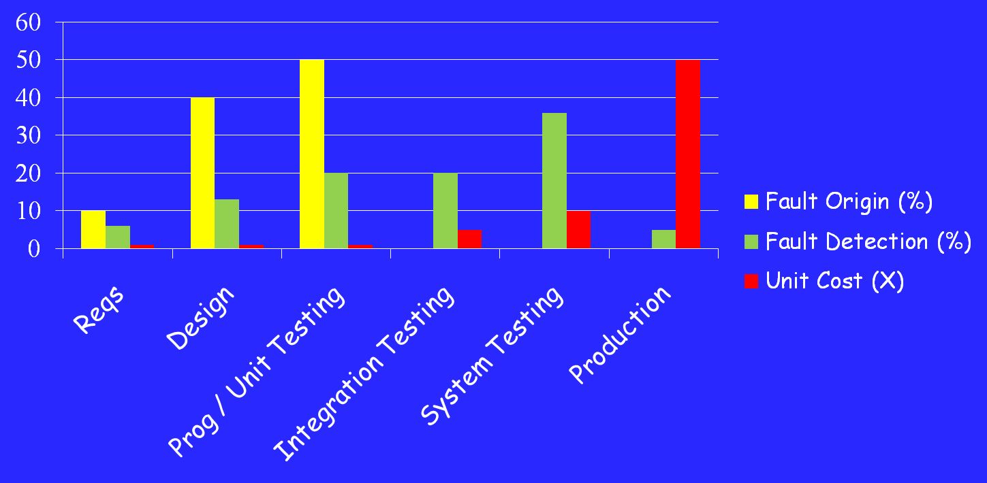
Cost of Late Testing
Assume $1000 unit cost, per fault, 100 faults
$250K
$360K
$20K
$100K
$13K
$6K
Software Engineering Institute; Carnegie Mellon University; Handbook CMU/SEI-96-HB-002
ITRI 2013

Slide 83
How to Improve Testing ?
Testers need more and better software tools
Testers need to adopt practices and techniques that lead to more efficient and effective testing
  More education
  Different management organizational strategies
Testing / QA teams need more technical expertise
  Developer expertise has been increasing dramatically
Testing / QA teams need to specialize more
  This same trend happened for development in the 1990s
ITRI 2013

Slide 84
Four Roadblocks to Adoption
Lack of test education
Necessity to change process
Usability of tools
Weak and ineffective tools
Bill Gates says half of MS engineers are testers, programmers spend half their time testing
Number of UG CS programs in US that require testing ?
0
Number of MS CS programs in US that require testing ?
0
Number of UG testing classes in the US ?
~30
Adoption of many test techniques and tools require changes in development process
This is very expensive for most software companies
Many testing tools require the user to know the underlying theory to use them
Do we need to know how an internal combustion engine works to drive ?
Do we need to understand parsing and code generation to use a compiler ?
Most test tools don’t do much – but most users do not realize they could be better
Few tools solve the key technical problem – generating test values automatically
ITRI 2013

Slide 85
Needs From Researchers
Isolate : Invent processes and techniques that isolate the theory from most test practitioners
Disguise : Discover engineering techniques, standards and frameworks that disguise the theory
Embed : Theoretical ideas in tools
Experiment : Demonstrate economic value of criteria-based testing and ATDG (ROI)
  Which criteria should be used and when ?
  When does the extra effort pay off ?
Integrate high-end testing with development
ITRI 2013

Slide 86
Needs From Educators
Disguise theory from engineers in classes
Omit theory when it is not needed
Restructure curriculum to teach more than test design and theory
  Test automation
  Test evaluation
  Human-based testing
  Test-driven development
ITRI 2013

Slide 87
Changes in Practice
Reorganize test and QA teams to make effective use of individual abilities
  One math-head can support many testers
Retrain test and QA teams
  Use a process like MDTD
  Learn more testing concepts
Encourage researchers to embed and isolate
  We are very responsive to research grants
Get involved in curricular design efforts through industrial advisory boards
ITRI 2013

Slide 88
Future of Software Testing
Increased specialization in testing teams will lead to more efficient and effective testing
Testing and QA teams will have more technical expertise
Developers will have more knowledge about testing and motivation to test better
Agile processes put testing first—putting pressure on both testers and developers to test better
Testing and security are starting to merge
We will develop new ways to test connections within software-based systems
ITRI 2013

Slide 89
Advantages of Criteria-Based Test Design
Criteria maximize the “bang for the buck”
  Fewer tests that are more effective at finding faults
Comprehensive test set with minimal overlap
Traceability from software artifacts to tests
  The “why” for each test is answered
  Built-in support for regression testing
A “stopping rule” for testing—advance knowledge of how many tests are needed
Natural to automate
ITRI 2013

Slide 90
Open Questions
Which criteria work best on embedded, highly reliable software?
  Which software structure to use?
How can we best automate this testing with robust tools?
  Deriving the software structure
  Constructing the test requirements
  Creating values from test requirements
  Creating full test scripts
  Solution to the “mapping problem”
Empirical validation
Technology transition
Application to new domains
ITRI 2013

Slide 91
Criteria Summary
Many companies still use “monkey testing”
  A human sits at the keyboard, wiggles the mouse and bangs the keyboard
  No automation
  Minimal training required
Some companies automate human-designed tests
But companies that also use automation and criteria-based testing
Save money
Find more faults
Build better software
ITRI 2013

Slide 92
Summary of Chapter 1’s New Ideas
Why do we test – to reduce the risk of using the software
Four types of test activities – test design, automation, execution and evaluation
Software terms – faults, failures, the RIP model, observability and controllability
Four structures – test requirements and criteria
Test process maturity levels – level 4 is a mental discipline that improves the quality of the software
Earlier and better testing can empower the test manager
ITRI 2013

Slide 93
A little practice of white-box testing
#include <stdio.h> /* printf, scanf, puts, NULL */
// #include <stdlib.h> /* srand, rand */
#include <time.h> /* time */
#include "stdlib_stub.h"
int main () /* rand example: guess the number */ {
int iSecret, iGuess, count; /* initialize random seed: */
srand (time(NULL)); /* generate secret number between 1 and 10: */
iSecret = rand() % 10 + 1;
for (count = 0; count < 10; count++) {
printf ("Guess the number (1 to 10): ");
scanf ("%d",&iGuess);
if (iSecret<iGuess)
puts ("The secret number is lower");
else if (iSecret>iGuess)
puts ("The secret number is higher");
else if (iSecret==iGuess) {
puts ("Congratulations!"); return 0;
} }
puts ("Sorry, game over!"); return 0;
}
0
1
2
12
0.
1.
2.
3.
4.
5.
6.
7.
8.
9.
10.
11.
12.
13.
3
13
4
11
6
5
8
7
9
10
ITRI 2013

Slide 94
A little practice of white-box testing
After the model has been constructed,
use tools to deduce test plans
Example:
  node coverage test case:
  0,1,2,3,4,5,6,11, 2,3,4,5,7,8,11,
  2,3,4,5,7,9,10,11, 2,12,13
  edge coverage test cases:
  0,1,2,3,4,5,6,11,2,3,4,5,7,8,11,
  2,3,4,5,7,9,10,11,2,3,4,5,7,9,11,2,12,13
  r0, 1, 2
Derive test input
Implement the test drive files
Implement the test stub files.
Collect test report.
0
1
2
12
3
13
4
11
6
5
8
7
9
10
ITRI 2013

